Slide 1

Notes:
page_number: true

Slide 2
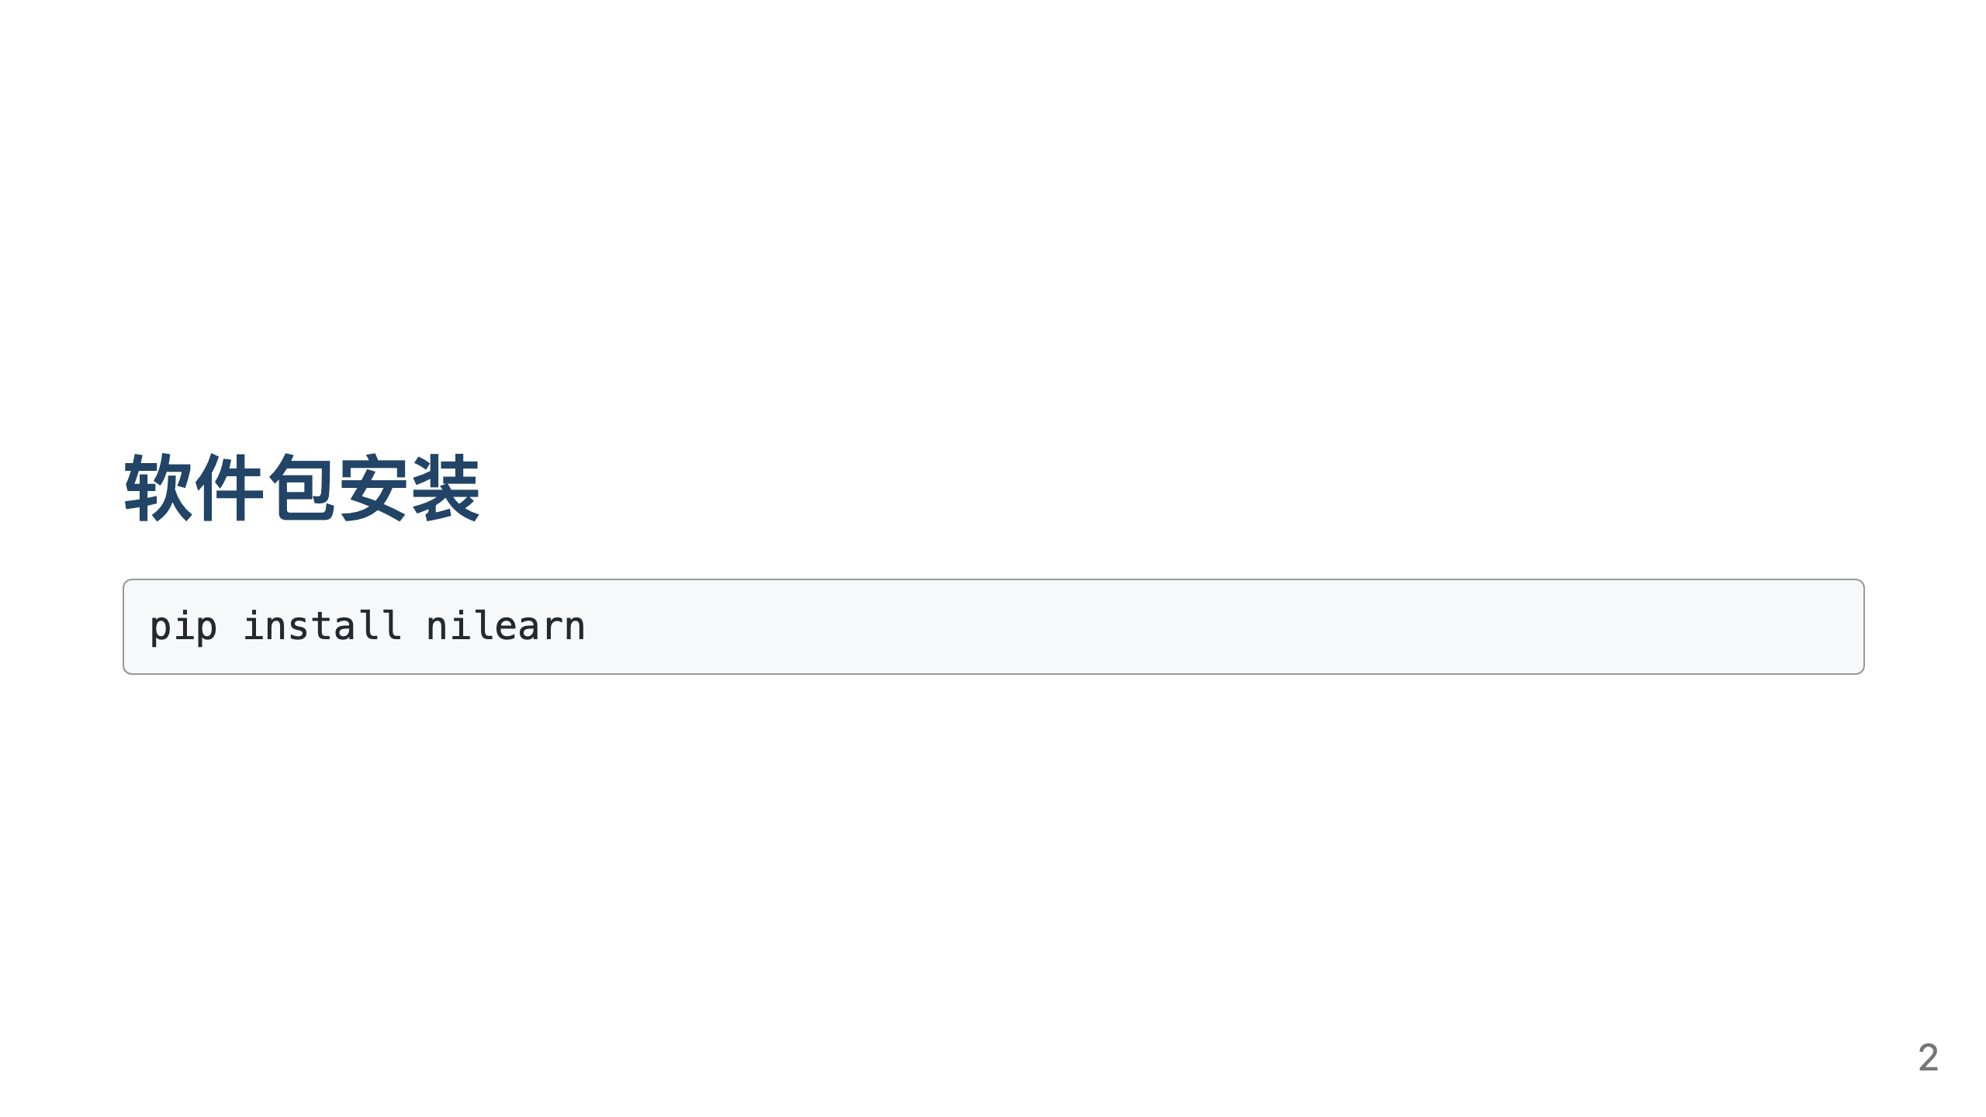

Slide 3


Slide 4
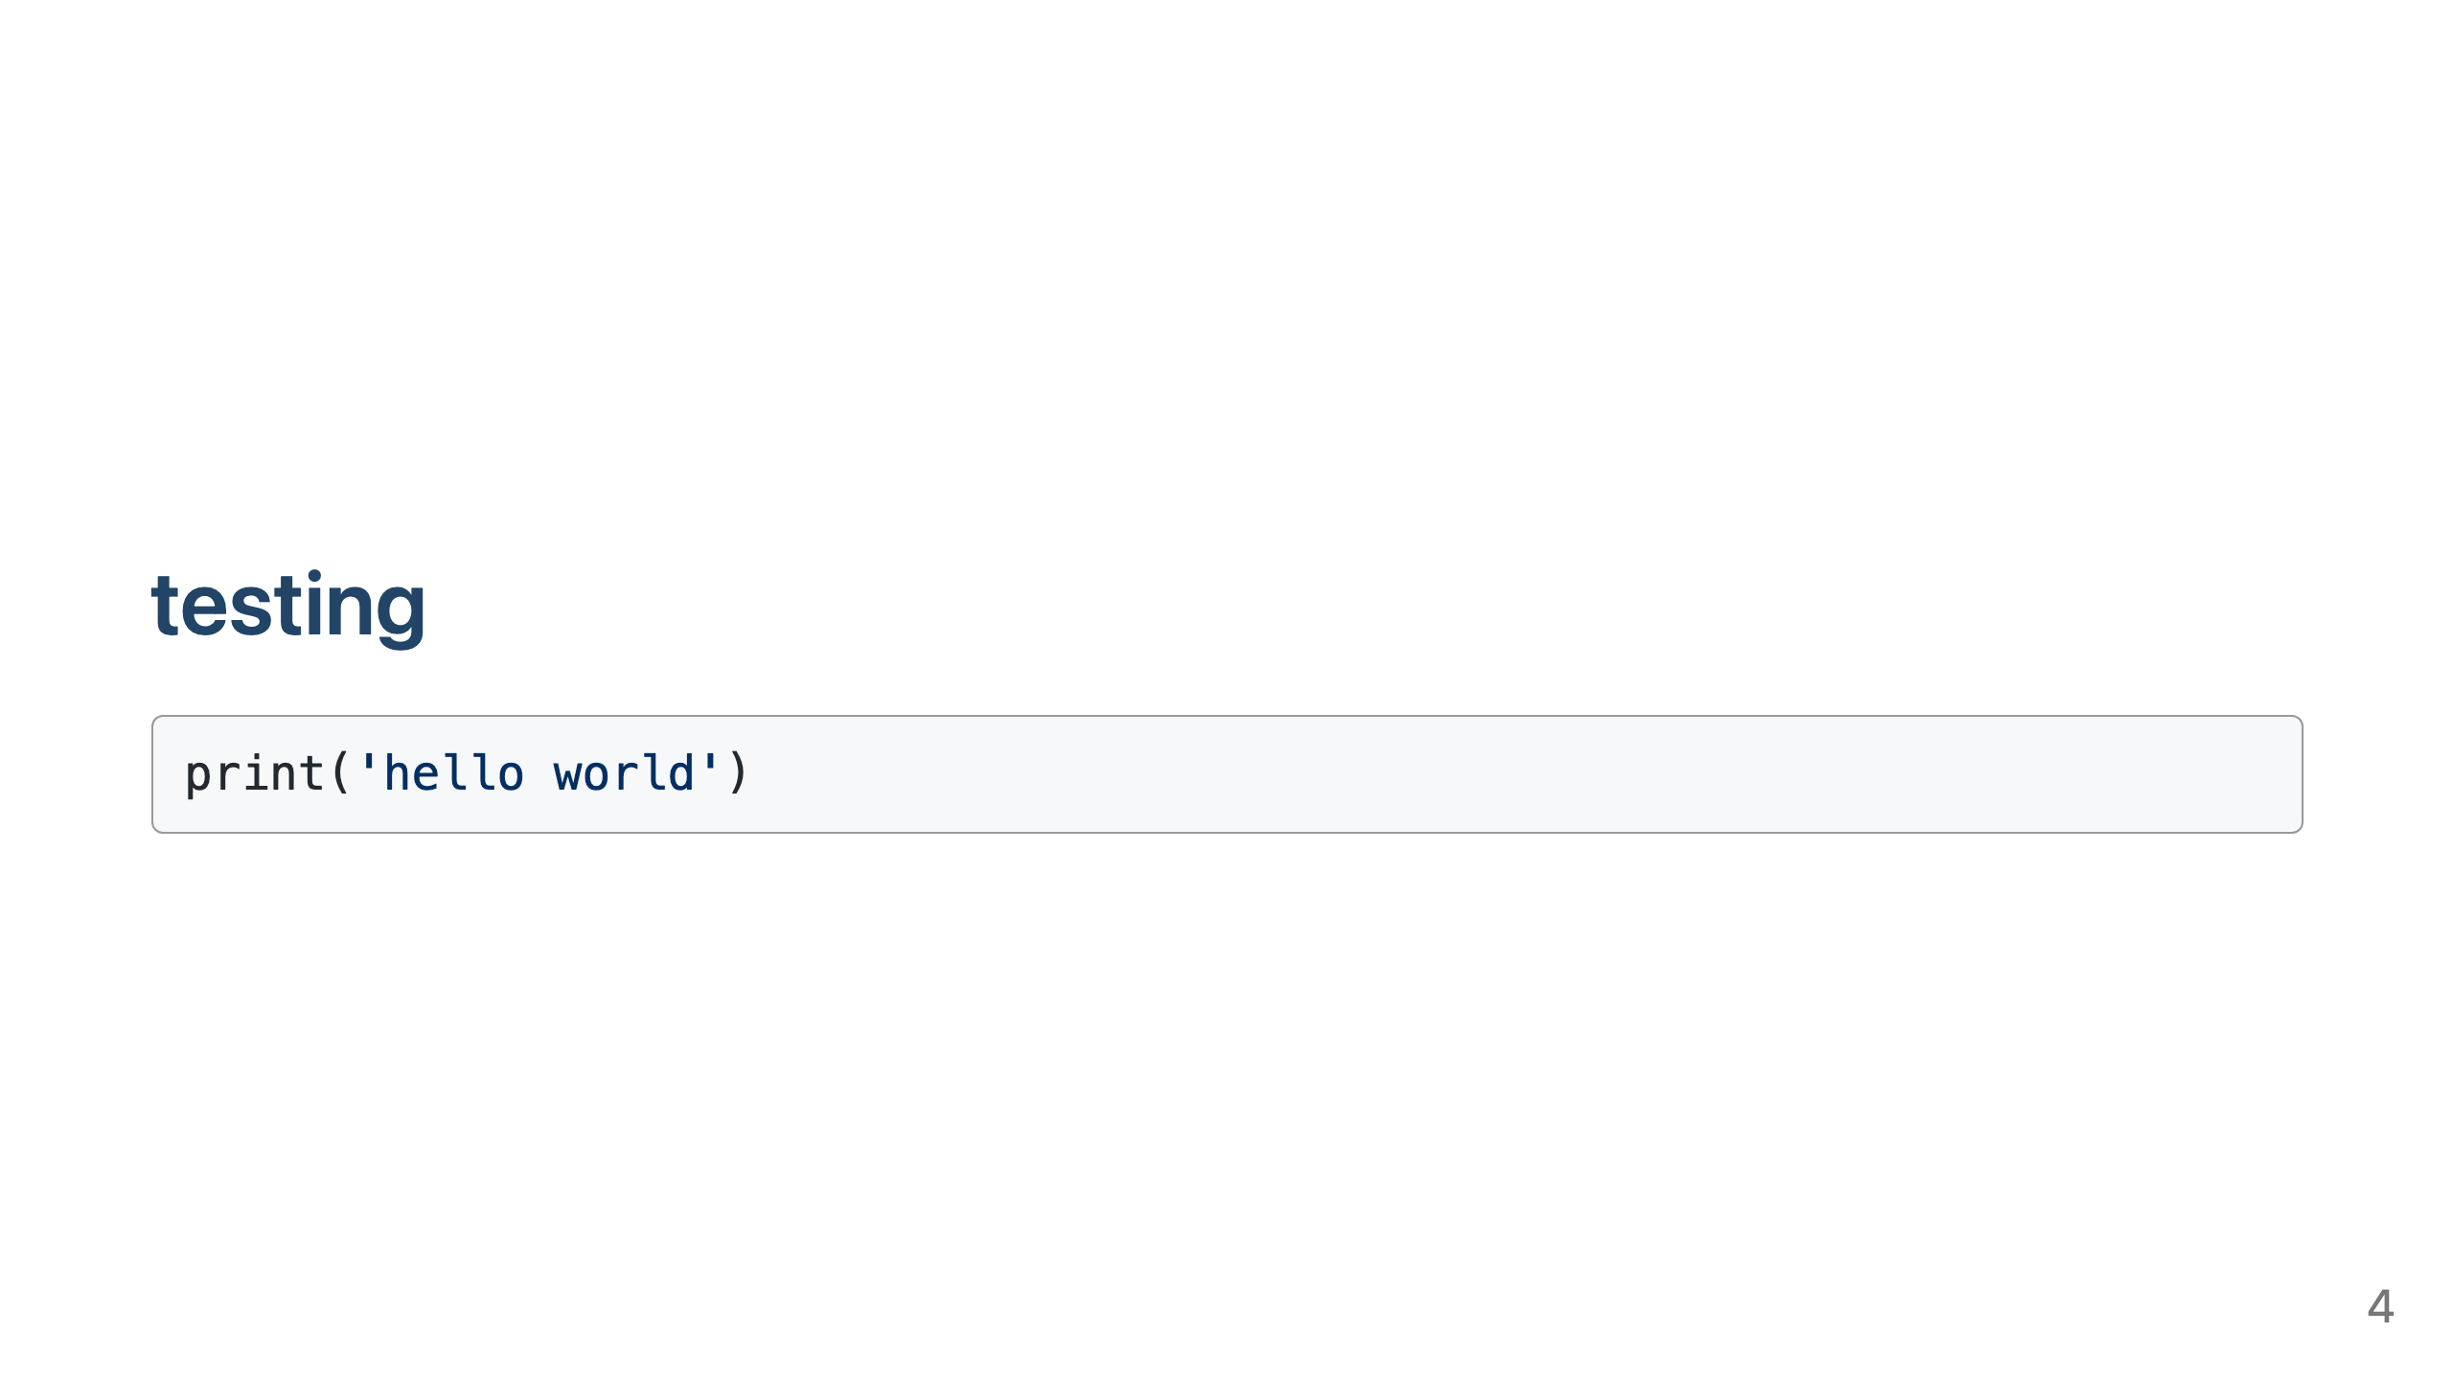

Slide 5
